Slide 1
Inventory Management System
Presented by:
Amina Ansar ( BSEF19M527)

Slide 2
Objectives:
Easy management of inventory.
Handel details of sales.
Make stock manageable.
Deals with day to day requirements of the users.
Keep a count of the stock left.
Keep a track on orders and customers.

Slide 3
How System Works?

Slide 4
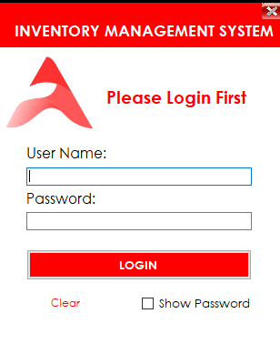
Login Form:
Login form is the first thing
to appear when you will run the Software.
Admin can Login the system through the login form.

Slide 5
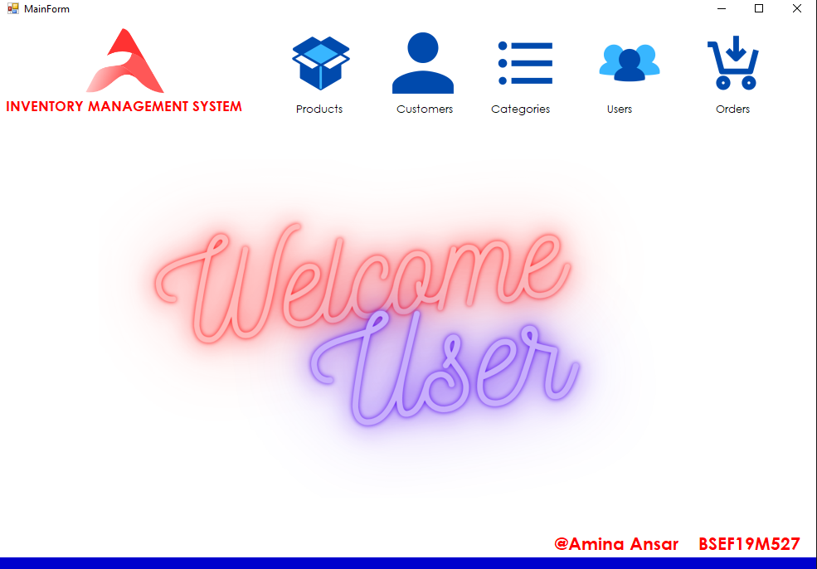
Main Form:
After logging-in the main form will appear on the screen.

Slide 6
Main Form Cont.
The main form gives access to the following:
Products
Customers
Categories
Users
Orders

Slide 7
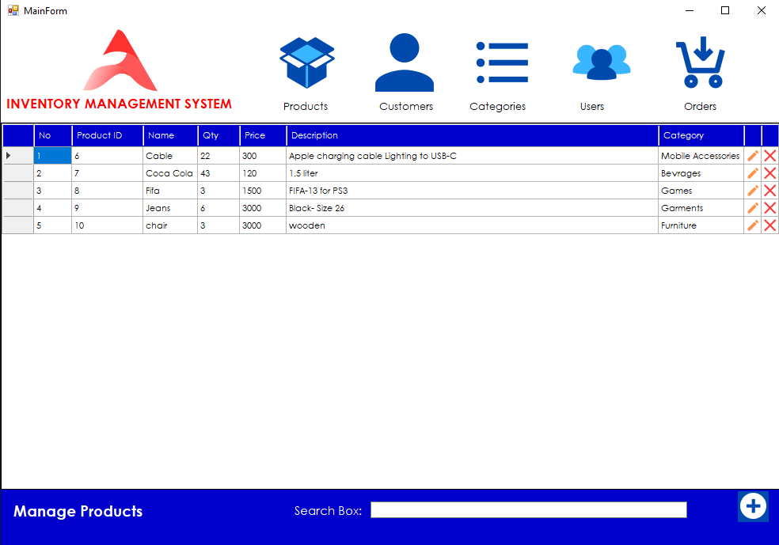
Layout:
All the Products, Users, Orders, Customers and Categories forms
have the following layout:

Slide 8
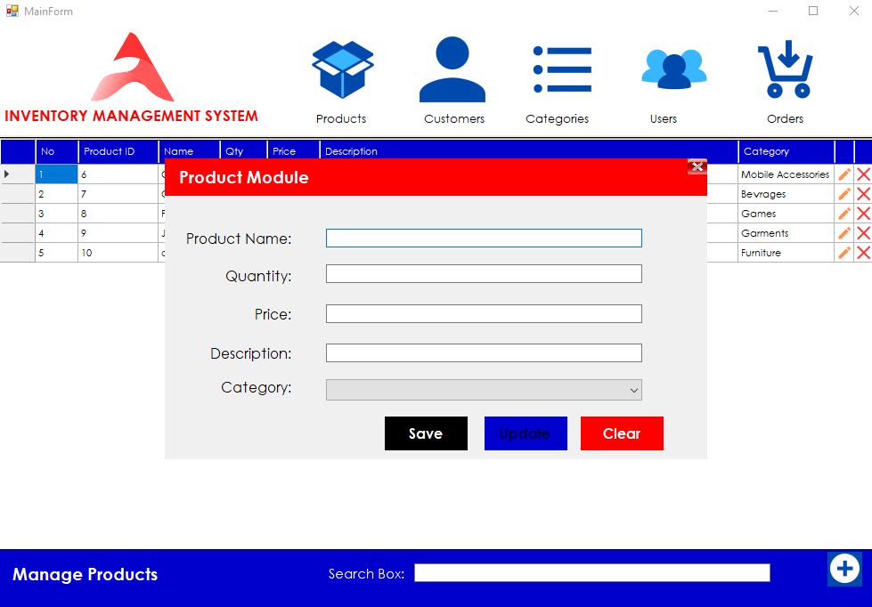
Module Form:
To add new users, orders, customers, categories, or products
a module form will appear on the screen as follow:

Slide 9
Here is a detailed video of the
working of the project.

Slide 11
Thank You!

